Slide 1

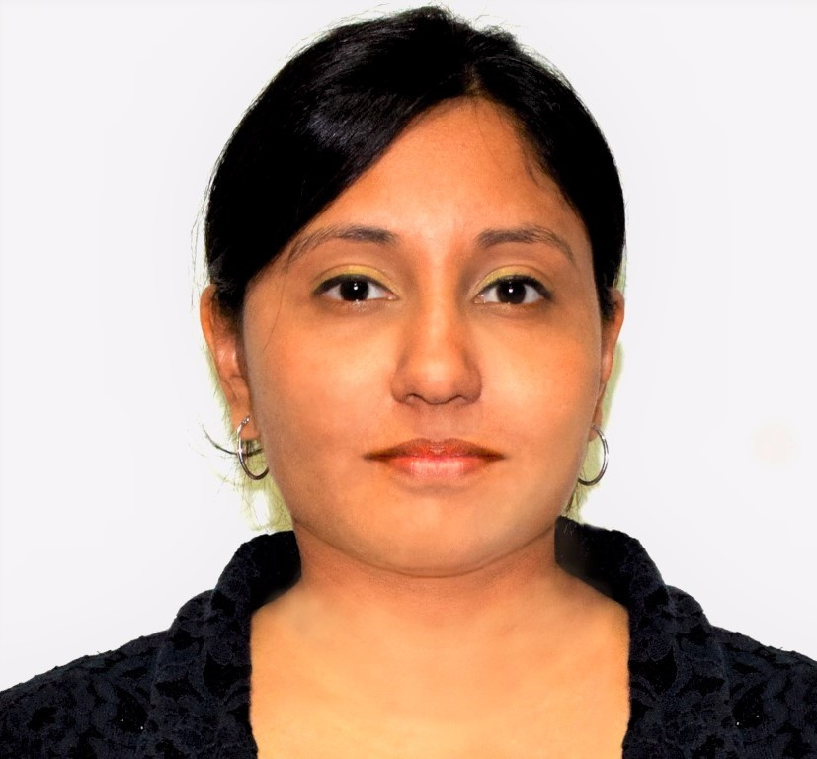

Selected project experience
Areas of expertise
Data Engineer (Apr 2020 – Present)
Design and Implement BI solutions using ELT approach and Azure environment
BI Project Lead (Jul 2018 – Mar 2020)
Project Lead for BI Projects. My role was to successfully deliver projects and manage stakeholder expectations
Senior Consultant (Jul 2008 – Jul 2018)
Team Lead for BI and ERP Projects. Designing and Implementing ERP and BI solutions using Sage Environment.
Functional
ELT Approach
Business Intelligence
Agile Delivery Mode
Data Warehousing
Data Modelling
Project Management
Industries
Energy Service Provider
Products
Technical
Power BI
VS
Git
SQL Server
T-SQL
SSIS
SSAS
SSRS
Azure Databricks
Azure Data Factory
Azure Analysis Services
Azure Devops
Jira
Divita
BUDDHOO - BISSOONDYAL
Application Development Specialist
Professional Background
BI Project Lead with more than 12 years of professional experience in the offshore and onshore projects.
Acquired knowledge in working on high-impact ERP/BI projects beginning with requirements analysis till post Go-Live Support
Education
Certifications
MBA with Specialization in Marketing
Open University of Mauritius, 2016
BSc(Hons) Computer Science​
University of Mauritius, 2008
AZ-900 Azure Fundamentals
Project Management Professional (PMP)®

Slide 2

Current Experience
Data Engineer
Skills & Technologies
I am responsible for the following project activities:
Data Transformation and Data Modelling for Finance and HR Module
Cross Team Communication (Onshore/Offshore)
Client interactions at different development stages
Participated actively in Daily Scrum, Scrum of Scrum, Sprint Demo, Retro and Sprint Planning
Technical Team lead for Offshore Team
Business Analyst consultant – Worked on SFD document, Data modelling in Visio and mapping of source data to destination fields
Post delivery support using Jira platform
Onboarding of new joiners to the project
Skills
Teamwork
Client facing
Analysis & solutions design
Scrum
Problem Solving
Data modelling
Technical
Azure DevOps
Azure Data Factory
Azure Databricks
Azure Analysis Services
SQL Server Management Studio
Visual Studio
Git
Power BI

Slide 3
Past Experience
BI Project Lead for a Mining Company
Project Lead and Follow up through Production Plan, Budget Control, Change Control and Risks Monitoring
Data modelling and loading using SEI Data warehouse
Development of BI Reports and dashboards with SEI / SI (Sage Intelligence)
Sage X3 Team Lead for a Pharmaceutical Company
Scope definition and Requirements gathering
Finance/Sales Technical and Functional consultant
Customised Reports using Crystal Reports
Key Users Training and Lead team for post go-live support
BI Project Lead for a Pharmaceutical Company
Onsite presence with clients to define requirements
Installation and Configuration of SEI on client side
Technical solution Architect
Lead team to develop KPIs, Dashboards and Financial Reports
Training of technical and functional key users for SEI
Areas of expertise
Functional
ERP
Business Intelligence
Reporting
Data Warehouse
Integration
SharePoint
Project Management
Industries
Mining
Energy Service Provider
Publishing Services
Shipping
Pharmaceutical
Finance and Audit
Technical
SEI/ SI Sage BI tools
Microsoft Report Builder
OBIEE
QlikView
Crystal Reports
VB
SQL Server
T-SQL
PL/SQL
SSIS
SSAS
SSRS
Specialized in development of BI Report and Dashboard using Sage Enterprise Intelligence (SEI) and ETL using SEI Data warehouse

